Slide 1
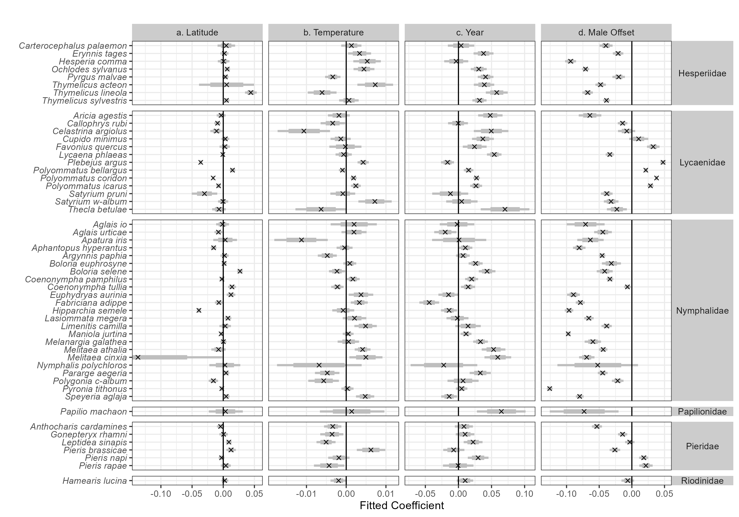
per unit latitude per °C per Century if Male
Fitted Coefficient Log-wing Size Change

